Slide 1
JSON, AJAX and XML

Slide 2
JSON example
“JSON” stands for “JavaScript Object Notation”
  Despite the name, JSON is a (mostly) language-independent way of specifying objects as name-value pairs
Example (http://secretgeek.net/json_3mins.asp):
  {"skillz": {
  "web":[
  { "name": "html",
  "years": 5
  },
  { "name": "css",
  "years": 3
  }]
  "database":[
  { "name": "sql",
  "years": 7
  }]
  }}

Slide 3
JSON syntax, I
An object is an unordered set of name/value pairs
  The pairs are enclosed within braces, { }
  There is a colon between the name and the value
  Pairs are separated by commas
  Example: { "name": "html", "years": 5 }
An array is an ordered collection of values
  The values are enclosed within brackets, [ ]
  Values are separated by commas
  Example: [ "html", ”xml", "css" ]

Slide 4
JSON syntax, II
A value can be: A string, a number, true, false, null, an object, or an array
  Values can be nested
Strings are enclosed in double quotes, and can contain the usual assortment of escaped characters
Numbers have the usual C/C++/Java syntax, including exponential (E) notation
  All numbers are decimal--no octal or hexadecimal
Whitespace can be used between any pair of tokens

Slide 5
eval
The JavaScript eval(string) method compiles and executes the given string
  The string can be an expression, a statement, or a sequence of statements
  Expressions can include variables and object properties
  eval returns the value of the last expression evaluated
When applied to JSON, eval returns the described object

Slide 6
JSON and—methods?
In addition to instance variables, objects typically have methods
There is nothing in the JSON specification about methods
However, a method can be represented as a string, and (when received by the client) evaluated with eval
  Obviously, this breaks language-independence
  Also, JavaScript is rarely used on the server side

Slide 7
Comparison of JSON and XML
Similarities:
  Both are human readable
  Both have very simple syntax
  Both are hierarchical
  Both are language independent
  Both can be used by Ajax
Differences:
  Syntax is different
  JSON is less verbose
  JSON can be parsed by JavaScript’s eval method
  JSON includes arrays
  Names in JSON must not be JavaScript reserved words
  XML can be validated
  JavaScript is not typically used on the server side

Slide 8
YAML
YAML can be taken as an acronym for either
  Yet Another Markup Language
  YAML Ain’t Markup Language
Like JSON, the purpose of YAML is to represent typical data types in human-readable notation
YAML is (almost) a superset of JSON, with many more capabilities (lists, casting, etc.)
  Except: YAML doesn’t handle escaped Unicode characters
  Consequently, JSON can be parsed by YAML parsers
When JSON isn’t enough, consider YAML

Slide 9
AJAX: Async JavaScript & XML
In traditional Web coding, to get information from a database or a file on the server
  make an HTML form
  GET or POST data to the server (click the "Submit" button)
  the browser loads a results page.
Because the server returns a new page each time the user submits input, traditional web applications can run slowly and tend to be less user-friendly.

Slide 10
AJAX: Async JavaScript & XML
AJAX does not require the page to be reloaded
  Instead JavaScript communicates directly with the server using the XMLHttpRequest object
The user will stay on the same page, and he or she will not notice that scripts request pages, or send data to a server in the background.
Because it’s asynchronous, the browser is not locked up

Slide 11
XMLHttpRequest or JQuery
Methods to handle comms
  Very tedious
JQuery
  $.ajax({
  url: 'document.xml',
  type: 'GET',
  dataType: 'xml',
  timeout: 1000,
  error: function(){alert('Error loading XML'); }, success: function(xml){do something}
  });

Slide 12
Example Success Function
success: function(xml){
$(xml).find('item').each(function(){
var item_text = $(this).text();
$('<li></li>')
.html(item_text)
.appendTo('ol');
});
}

Slide 13
Simpler AJAX
Often, you simply need to pass some parameters to a page on the server.
$.post('save.cgi', {text: 'my string', number: 23}, function() {alert('Your data has been saved.');});

Slide 14
Simplest AJAX
A common use of Ajax is to load a chunk of HTML into an area of the page. To do that, simply select the element you need and use the load() function.
  $('#stats').load('stats.html');

Slide 15
Trouble with AJAX
Two problems with AJAX
  Security model
  XML
Most browsers prohibit AJAX calls to different domains
XML is tedious to parse and use
  Can serialise data as JavaScript objects!

Slide 16
JSON: JavaScript Object Notation
Basic types are
  Number integer, real, or floating point
  String double-quoted Unicode with backslashes
  Boolean true and false
  Array ordered sequence of comma-separated values enclosed in square brackets
  Object collection of comma-separated "key":value pairs enclosed in curly brackets
  null

Slide 17
JSON: JavaScript Object Notation
{ "firstName": ”Leslie", "lastName": ”Carr",
"age": 43,
"address": {
"streetAddress": "21 Foo Str”,
"city": "New York"
},
"powers": [1, 2, 4, 8, 16, 32]
}
var p = eval("(" + JSON_text + ")");
alert(p.age);

Slide 18
JSON-P: JavaScript Object Notation
foo(
{ "firstName": ”Leslie", "lastName": ”Carr",
"age": 43,
"powers": [1, 2, 4, 8, 16, 32]
}
)
Bypasses security by pretending to be a script
API calls have a callback=foo parameter
  i.e. client tells the server what callback to invoke on the returned data

Slide 19

JSON/JQuery Flickr Example
$.getJSON("http://api.flickr.com/services/feeds/photos_public.gne?tags=cat&tagmode=any&format=json&jsoncallback=?",
function(data){
$.each(data.items, function(i,item){
$("<img/>").attr("src", item.media.m).appendTo("#images");
if ( i == 3 ) return false;
});
});

Slide 20
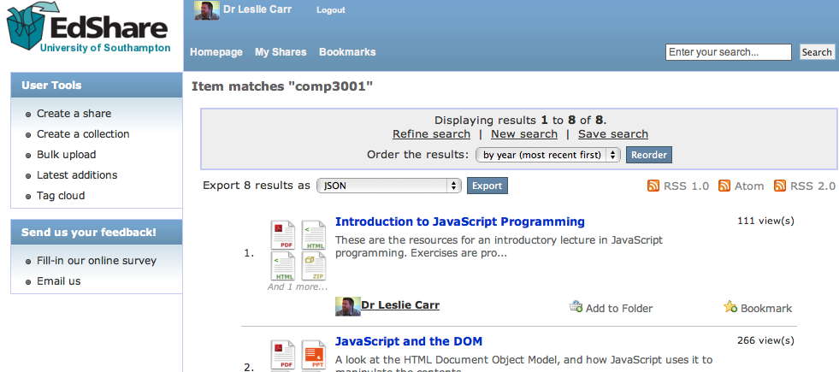
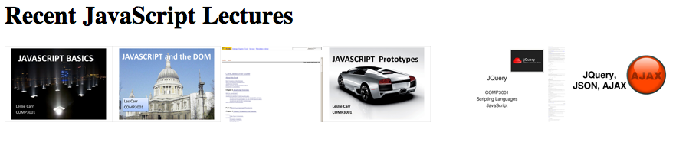

EPrints
$(document).ready(function(){
$.getJSON("http://www.edshare.soton.ac.uk/cgi/search/simple/export_edshare_JSON.js?exp=…..comp3001…&jsonp=?",
function(data){
$.each(data, function(i,item){
$("<a/>").
attr("href","http://edshare.soton.ac.uk/"+item.eprintid).append(
$("<img/>").
attr("src","http://edshare.soton.ac.uk/"+item.eprintid+"/thumbnails/1/preview.png").
bind("error",function(){$(this).addClass("hidden")})
).appendTo("#lectures");
});
});
});

